Slide 1

Long COVID: What we know about a new infection-associated illness
David Putrino, PT, PhD
Associate Professor of Rehabilitation and Human Performance
Director of Rehabilitation Innovation
Co-Director, Abilities Research Center
Director, Charles Lazarus Children’s Abilities Center
Director, Performance360

Slide 2


Slide 3
Long COVID: What are we treating?
Long COVID and/or Post-Acute Sequelae of COVID (PASC):
Umbrella terms that refer to a range of “new, returning, or ongoing health problems” experienced by people four or more weeks after initial coronavirus infection.
Long COVID is an “infection-associated illness”

Slide 4
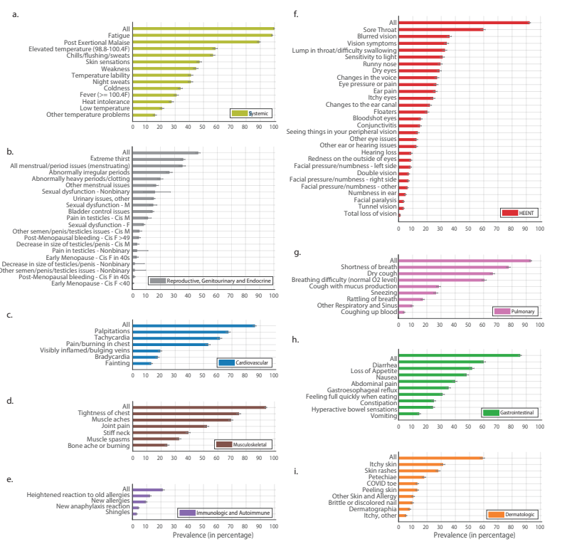
Long COVID – The Symptom Catalogue
>205 Symptoms
10 Organ systems
Davis et al, 2021

Slide 5
Long COVID – Impact on daily participation
40% of patients reported moderate to severe shortness of breath (MRC Breathlessness Scale)
78% of patients reported problematic fatigue (Fatigue Severity Score)
63% of patients scored for at least mild cognitive impairment (Neuro-Qol)
62% of patients have had to change their employment status as a result of their symptoms
Tabacof et al, (2022)

Slide 6
Long COVID: How are we treating it?

Slide 7
A typical Long COVID care pathway
Initial evaluation (physician)
Referral to breathwork coaching for prehab
Referral to specialties care (Nutrition, Cognitive rehab, Neuropsychology, etc)
Cardiac clearance (EKG/Echo)
Referral to physical therapy for Autonomic Rehabilitation
Begin work on behavioral strategies to get symptom attacks under control

Slide 8
Full workup and cardiac “clearance”
Initial evaluation (physician)
Referral to breathwork coaching for prehab
Referral to specialties care (Nutrition, Cognitive rehab, Neuropsychology, etc)
Cardiac clearance (EKG/Echo)
Referral to physical therapy for Autonomic Rehabilitation
Begin work on behavioral strategies to get symptom attacks under control

Slide 9
Long COVID – Triggers and how to avoid them
Physical or cognitive exertion (86%)
Stress (69%)
Dehydration (49%)
Weather changes (37%)
Consuming large meals (28%)
Premenstrual period (22%)
Alcohol consumption (22%)
Pacing/Energy conservation
Environmental planning/control
Hydration plan *with* electrolytes
Planning meals and mealtimes
Strategies for blood pressure regulation
Mindfulness about caffeine and alcohol consumption
Tabacof et al, (2022)

Slide 10
Strategies for symptomatic relief of Long COVID
Initial evaluation (physician)
Referral to breathwork coaching for prehab
Referral to specialties care (Nutrition, Cognitive rehab, Neuropsychology, etc)
Cardiac clearance (EKG/Echo)
Referral to physical therapy for Autonomic Rehabilitation
Begin work on behavioral strategies to get symptom attacks under control

Slide 11
Strategies for symptomatic relief of Long COVID
Initial evaluation (physician)
Referral to breathwork coaching for prehab
Referral to specialties care (Nutrition, Cognitive rehab, Neuropsychology, etc)
Cardiac clearance (EKG/Echo)
Referral to physical therapy for Autonomic Rehabilitation
Begin work on behavioral strategies to get symptom attacks under control

Slide 12
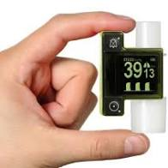
CO2 Levels, breath work and Long COVID
*
Wood et al, 2021

Slide 13
Strategies for symptomatic relief of Long COVID
Initial evaluation (physician)
Referral to breathwork coaching for prehab
Referral to specialties care (Nutrition, Cognitive rehab, Neuropsychology, etc)
Cardiac clearance (EKG/Echo)
Referral to physical therapy for Autonomic Rehabilitation
Begin work on behavioral strategies to get symptom attacks under control

Slide 14
Cognitive Rehab
?
Very little good news
Autonomic rehabilitation might help, but not consistently
Brain games, etc don’t appear to work and can be needless exertion
Lifestyle strategies help with management of symptoms

Slide 15
Strategies for symptomatic relief of Long COVID
Initial evaluation (physician)
Referral to breathwork coaching for prehab
Referral to specialties care (Nutrition, Cognitive rehab, Neuropsychology, etc)
Cardiac clearance (EKG/Echo)
Referral to physical therapy for Autonomic Rehabilitation
Begin work on behavioral strategies to get symptom attacks under control

Slide 16
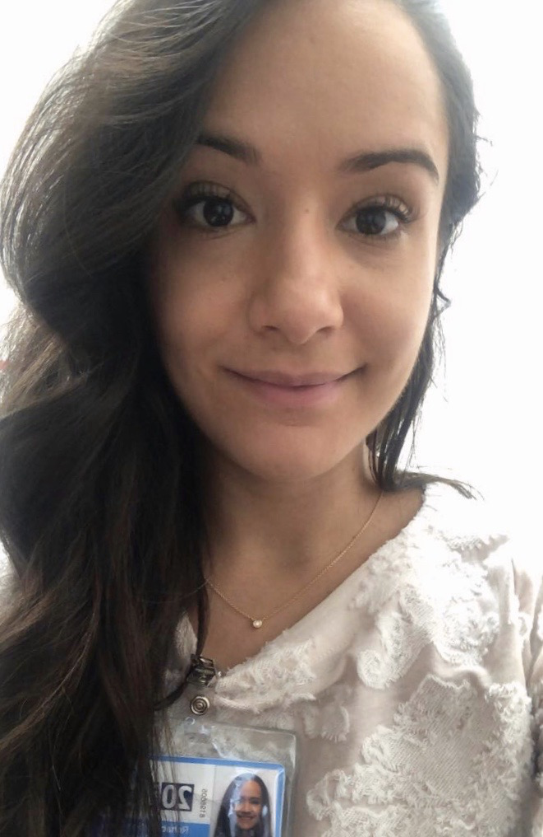
Autonomic Rehabilitation
This is NOT exercise therapy to treat “deconditioning”
Long COVID is NOT deconditioning
This is rehabilitation that is specifically designed to treat autonomic dysfunction
In the majority of cases we start with specific body movements that will trigger slight autonomic activity and we train gentle regulation techniques and progress position and context from there.
If someone starts you off at the Levine Protocol/aerobic exercise level on visit 1, they are not doing autonomic rehabilitation correctly
This is intense, time-consuming and challenging rehabilitation

Slide 17
Autonomic rehabilitation - know your symptoms!
Fatigue
A feeling of weariness, tiredness, or lack of energy
Exercise Intolerance
Inability to engage in exercise
Immediate onset: patient must stop during activity due to symptoms
Post-exertional Symptom Exacerbation
Sometimes called “Post-exertional Malaise”
Exertion can be physical, cognitive or emotional
Can be physical, emotional or cognitive
Persistent and debilitating
Delayed-onset: exertion can trigger symptoms days later
Severe symptom flairs as a result of exertion

Slide 18
Autonomic rehabilitation eases Long COVID symptoms and improves function (n = 113)
*
*
*
*
Baseline
Follow-up

Slide 19


Additional resources

Slide 20
Treating the source: exploring the pathogenesis of Long COVID

Slide 21
Multiple potential underlying causes
Viral Persistence
Virus or spike proteins are not adequately being cleared by the body
Chronic Inflammation
An initial, strong inflammatory response to the virus (cytokine storm) has led to a self-sustaining inflammatory process that is now causing damage
Autoimmunity
The initial immune response to the virus has triggered a physiological reaction where the body begins to produce molecules that attack itself
Vascular Pathology
Endothelial dysfunction resulting in inflammation, platelet pathology and “microclot” formation

Slide 22




Slide 23
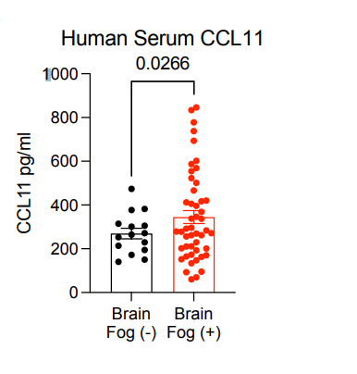
Autoantibodies and cytokines
We’re seeing findings consistent with autoimmunity in many patients:
  Biomarkers of overactive B Cell immunity
  Significant autoantibody production
However, these biomarkers may be symptom- and person-specific
We do not have targeted treatments for these findings
Mehandru et al., 2022

Slide 24


Viral Persistence
Viral persistence and spike proteins have been found in patients with Long COVID
Partnering with Amy and Saurabh to push this research to the next level
Understanding HOW persistent virus may be interacting without the surrounding tissue

Slide 25
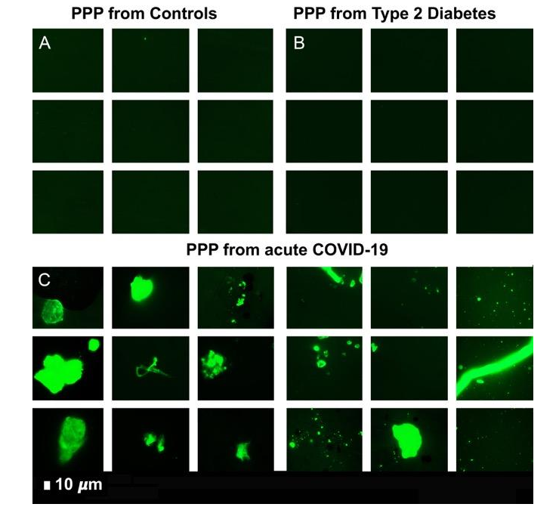
#TeamCLOTS!
Resia Pretorius, Douglas Kell, Asad Kahn, Martin Kraeter, Beate Jaeger, Anna Brooks, Jaco Laubscher + 20 other phenomenal scientists all around the world are chasing this theory
People with Long COVID show signs of platelet pathology and microclot formation
Pretorius et al., 2021

Slide 26




Acknowledgements
Our caring doctors and therapists
Our amazing interns and past lab members
All of our patients and the incredible patient-led groups
Mount Sinai Team
Joe Herrera
Lori McKenna
Melissa Gunning
Mariam Zakhary
Angela Riccobono
Dayna McCarthy
Abilities Research Center
Jenna Tosto-Mancuso
Laura Tabacof
Jamie Wood
Mar Cortes
Erica Breyman
Leila Nasr
Loreene Correa-esnard
Katie Malone
Keith Embler
Adam Fry
Gabby Rozanski
Wife (long-suffering)
Rose Perry
@PutrinoLab
@putrino_lab

